Slide 1
Contact Center Case Study
Pawan Pohani

Slide 2
Problem Statement & Scope of Case Study
Problem Statement – High Average Handling Time (AHT) in contact center.
Scope of Case Study -
Landscape of Data
Descriptive Analytics
Proposed Solution
Predictive Analytics

Slide 3
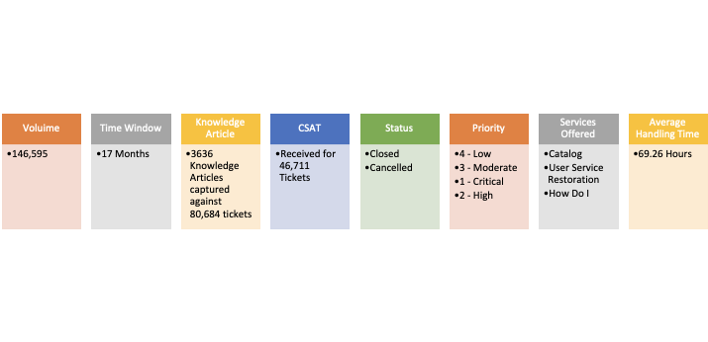
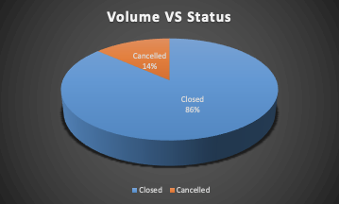
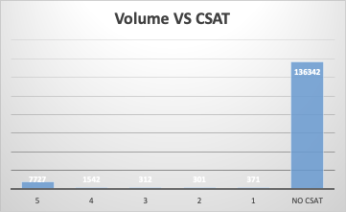
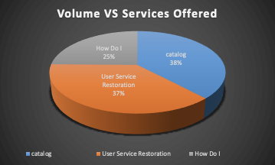
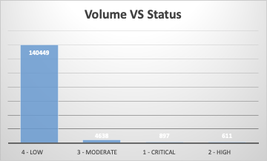
Landscape of Data

Slide 4
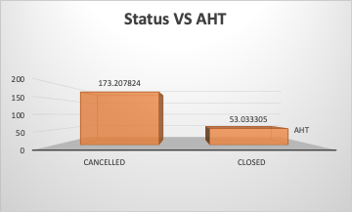
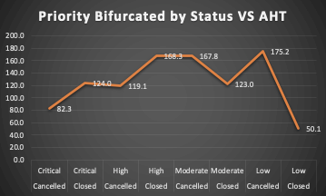
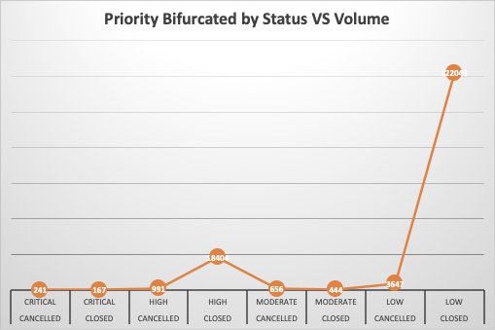
Descriptive Analytics - AHT on Scale of Status & Priority
Cancelled tickets are 10% of Closed tickets, still AHT of cancelled ticket is around 3.5 times of Closed Tickets.
While team has enough capacity to close huge volume of Low priority tickets under AHT, on other category of tickets AHT is above cumulative AHT.

Slide 5
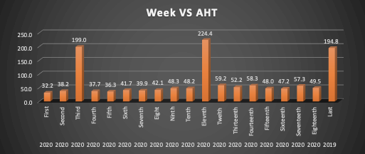
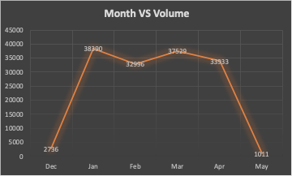
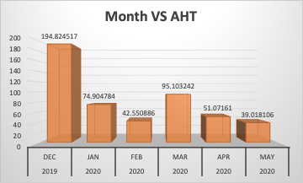
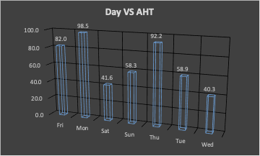
Descriptive Analytics – AHT On Scale of Different Timelines
Lowest volume was observed in Dec 2019, still AHT was highest.
AHT in 2020 is improved from 2019, but in 2020, for few weeks & months AHT has fluctuated by a big margin. Such fluctuations in future can upset AHT.
In 2020, most of the times AHT has increased as weeks have passed.
Out of 7 days of week, AHT of 3 days is well above cumulative AHT.

Slide 6
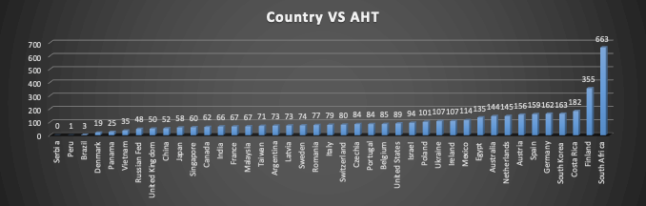
Descriptive Analytics – AHT On Scale of Geography & CSAT

Slide 7
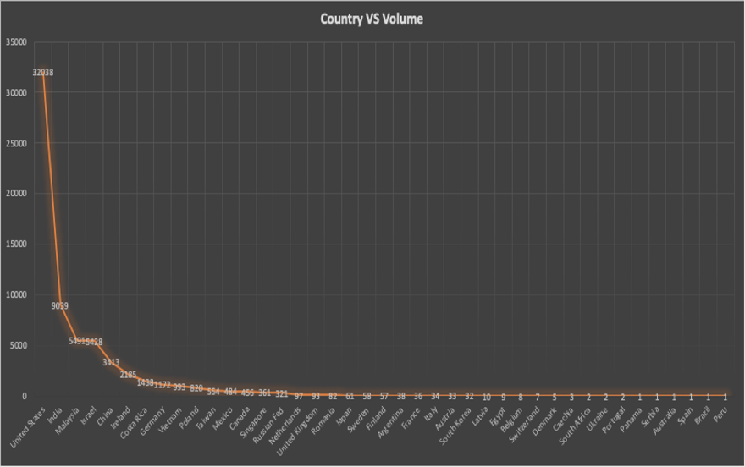
Descriptive Analytics – AHT On Scale of Different Timelines & CSAT...cont.

Slide 8
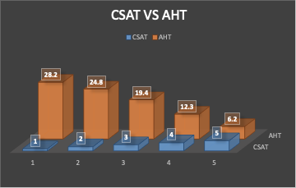
Descriptive Analytics – AHT On Scale of Different Timelines & CSAT...cont.
With Moderate volume India & China has AHT below cumulative AHT, while with highest volume USA has AHT reasonably over cumulative AHT.
This shows that Volume is not directly related to AHT.
CSAT is giving an incomplete picture as for most of the tickets CSAT is not captured.
For many tickets Country is not captured in data.

Slide 9
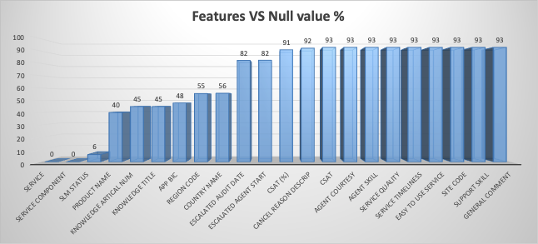
Descriptive Analytics – Data Gathering
Out of 48 Features, 22 features have invalid (Null) value.
15 features have more than 50% Null Value while 11 features have more than 90% Null Values.
This missing data can be a loosen end.

Slide 10

Proposed Solution
CSAT - CSAT needs to be collected for all Tickets diligently.
Status -
Cancelled tickets need to be analyzed to find where gap lies.
Team's skills & capacity need to be re-evaluated to find reason behind high AHT for most of the tickets.
Process for Data Gathering needs to be in place to ensure that all data is captured well-times as per defined process.
Stakeholder Management – Out of regular window, feedback can be taken from all stakeholders to bridge the gaps.
Support Plan - Support Plan artifacts (such as shift rotation plan, RACI) needs to be revisited.
Knowledge Base - Every ticket should be linked to a 'Knowledge Article'. On the basis of priority and team's capacity, separate time can be taken out for building Knowledge Articles.

Slide 11
Predictive Analytics
Using Supervised Machine Learning Technique a Regression Predictive Model is bulit to predict Total Resolution Time in hours, which will help to predict Average Handling Time.
Build of this model is divided into below sections: -
Feature Engineering
Model Selection Strategy

Slide 12
Feature Engineering
Different Features were analyzed on the basis of Null Values to refine the input data to Regression Model.
Below Features were removed: -
Removed Features' List
Created Calendar Date | Knowledge Artical Number
Escalated Audit Date | CSAT
Cancel Reason Description | Site Code
Country Name | APP BIC
Service Timeliness | Knowledge Title
Submit Date | Agent Courtesy
Escalated Agent Start Date | Support Skill
CSAT (%) | Last Resolved Date
Region Code | Product Name
Easy To Use Service | Agent Skill
Escalated Agent Start Date | General Comment
Short Description

Slide 13
Feature Engineering..cont.
Using IQR Outlier Detection Method data was refined. It's statistics are: -
Lable Encoding applied on below Categorical Features: -
 | Total Observations | Number of Features
Data before removal of Outliers | 1,46,595 | 25
Data after removal of Outliers | 55,986 | 25
Processed Categorical Variables
Service | Resolved Agent Service Desk | TAC Resolved
Service Component | Resolved Agent Team | Reopened
SLM Status | Status Class | Reopened E2E
Day | Service Sub Type | TTR Less Than or Equal to 1 hr
Resolved Client Year WorkWeek | Priority | TTR Less Than or Equal to 90 min
Resolved Client Year Month | Escalated Flag | TTR Less Than or Equal to 30 min
Resolved Client Year Quarter | Service | Month
Contact Type | Service Component

Slide 14
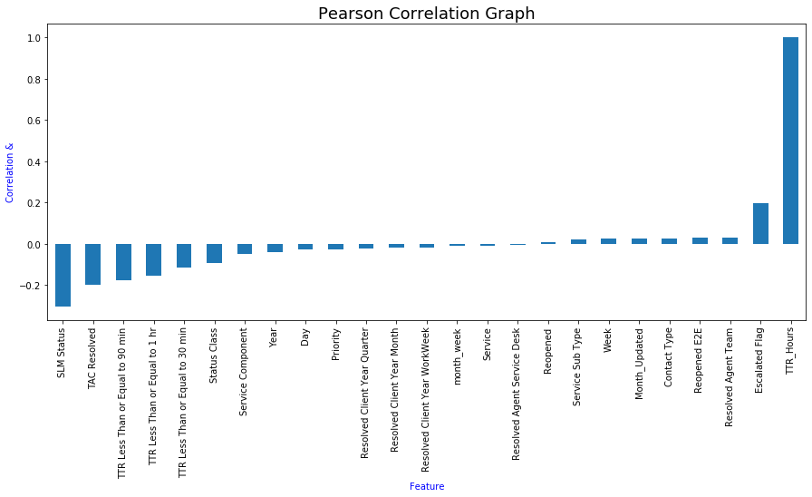
Feature Engineering..cont.
'Person Correlation' technique' was applied. Since all features have weak correlation with target variable, no feature was removed.

Slide 15
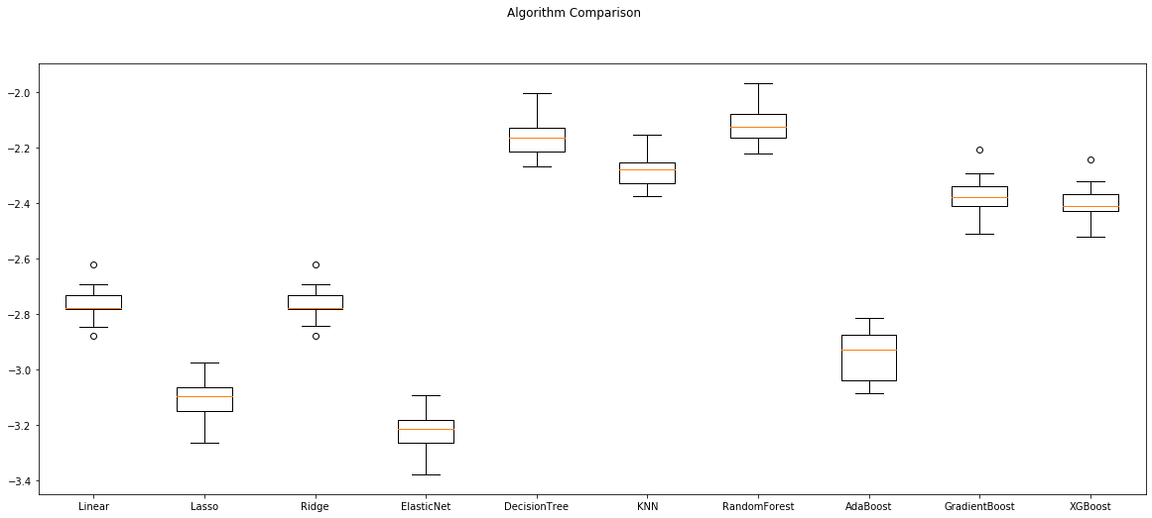
Model Selection Stragtegy..cont.
Multiple Regression Machine Leraning Model was executed and compared on scale of 'Mean Absloute Error'.
Since Random Forest has given best result, it was picked to train the model and predict the data on test data. Alernatively 'Artificial Nueral Network' was also tried to train the data and make predictions on test data. Statistics are: -
Test : Train - .8 : .2
 | Random Forest | ANN
Mean Absolute Error | 2.04 | 2.03
Mean Squared Error | 21.64 | 27.04
Root Mean Squared Error | 4.645 | 5.2
Layer # | Nuerons #
1 | 128
2 | 256
3 | 256
4 | 1

Slide 16
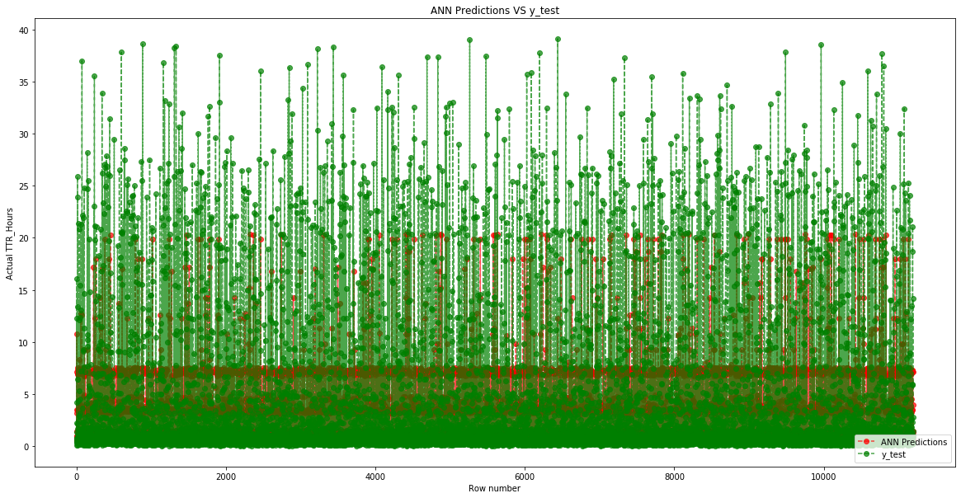
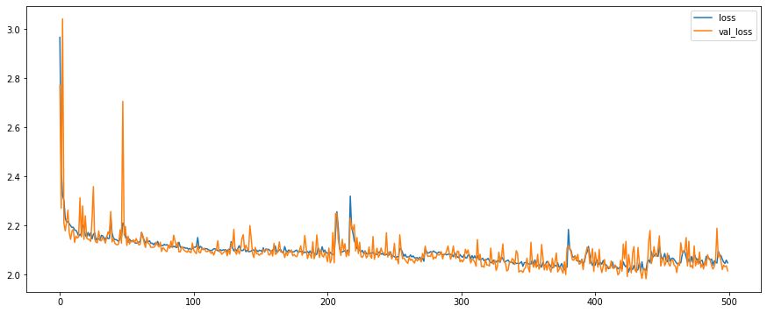
Model Selection Stragtegy...cont.
On scale of Mean Absloute Error, ANN is picked as final model.

Slide 17
Assumptions
Data belongs to a Support Project.
'TTR Less Than or Equal to 1 hr', 'TTR Less Than or Equal to 90 min' and 'TTR Less Than or Equal to 30 min' are benchmark provided by client. They don't reflect anything on expected AHT.
Analysis of time (year, day, month or week) is scaled on Last Resolved Date.
Approaches for Model Deployment is parked for next stage.
Currently Choosen model is suggested on basis of Mean Absloute Error only.
During Model Deployment further details of Models such as Size & Total execution time would be provided so that client can choose Predictive Model.
Knowledge Articles are knowledge base document carrying detailed steps of resolution of respective ticket.
Correlation less than 40% or greater than –40% is considered as weak correlation.
Few techniques, such as Feature Importance, Hyper parameter tunning, analysing features using Heat Map are parked for later stage.

Slide 18
Thank You!

